Slide 1

A Hands-on Introduction to Machine Learning
6. Classification-2

Slide 2
What we will cover
Logistic regression
Softmax regression
Naïve Bayes
Support Vector Machine (SVM)

Slide 3
Logistic regression (LR) – 1 of 2
LR is a statistical method used in ML for binary classification tasks. It predicts the probability that a given input belongs to a particular category.
Its main goal is to find the relationship between features and the probability of a particular outcome. For instance, it can predict whether an email is spam or not spam.
It uses the logistic function, also known as the sigmoid function, to model the probability that a given input point belongs to a certain class. The output is a value between 0 and 1, representing this probability.
Widely used in fields like medicine (disease diagnosis), finance (credit scoring), and marketing (customer conversion predictions).

Slide 4
LR – 2 of 2
Use of sigmoid function to turn a continuous predicted value to something bound between 0 and 1, and then to Class-1 (below 0.5) and Class-2 (above 0.5).

Slide 5
LR Model training – 1 of 2
The model is trained using a method called "maximum likelihood estimation" to find the best coefficients that minimize the difference between predicted probabilities and actual class labels in the training data.
In LR, the training process involves optimizing an objective function, known as the "log-likelihood function". The goal is to maximize this function, which measures how well the model's predicted probabilities match the actual class labels in the training data.
To find the best model parameters (coefficients), LR commonly uses an optimization algorithm called "gradient descent". This method iteratively adjusts the parameters to move towards the maximum of the log-likelihood function.

Slide 6
LR Model training – 2 of 2
During training, the learning rate determines how big a step is taken at each iteration of gradient descent. A properly chosen learning rate helps the model to converge more efficiently to the optimal solution.
The training process continues until the model reaches a point where the log-likelihood function no longer improves significantly with further adjustments to the parameters, indicating that the model has converged to its optimal state.
To prevent overfitting, especially when dealing with high-dimensional data, LR can include regularization terms in its objective function. These terms penalize large coefficients and help to maintain a simpler, more generalizable mode

Slide 7
Softmax regression – 1 of 2
Softmax Regression, also known as Multinomial Logistic Regression, is an extension of logistic regression that handles multiple classes, making it suitable for multi-class classification problems.
Unlike binary logistic regression that predicts two possible outcomes, Softmax Regression can predict probabilities of multiple classes, making it ideal for scenarios where objects can belong to more than two categories.
Replace sigmoid function in logistic regression with softmax function
It applies the softmax function to the output of a linear model, converting raw scores called logits into probabilities by considering the relative scale of each logit.
Commonly used in areas such as image recognition, natural language processing, and any domain requiring classification among several categories.

Slide 8
Softmax regression – 2 of 2
This function takes a vector of n real numbers as input and normalizes the vector into a distribution of n probabilities
This function exponentiates each logit and divides it by the sum of all exponentiated logits, ensuring all probabilities sum up to 1.
The class with the highest probability after applying the softmax function is predicted as the output.
Softmax Regression is straightforward to implement, efficient for linearly separable problems, and integrates well into neural networks as a final layer for classification tasks.

Slide 9
Naïve Bayes – 1 of 3
Naïve Bayes is a classification algorithm based on Bayes' Theorem with an assumption of independence among predictors.
It calculates the probability of each class under the assumption that each feature is independent, to predict the class of unknown data points.
Widely used in spam filtering, sentiment analysis, and document classification due to its efficiency and simplicity.
It is fast, easy to implement, and performs well with a small amount of data.

Slide 10
Naïve Bayes – 2 of 3
Utilizes Bayes' Theorem to find the probability of a label given some observed features
Assumes all features are independent of each other, which simplifies calculation without significantly compromising performance in many cases.
During training, it calculates the probability of each class and the conditional probability of each class given each feature.
For a new data point, it calculates the posterior probability for each class and classifies the data point into the class with the highest probability.

Slide 11

Naïve Bayes – 3 of 3
$$P\left(c | x\right)=\frac{P\left(x | c\right)P\left(c\right)}{P\left(x\right)}$$
P(c|x) is the posterior probability of class (c, target) given predictor (x, attributes).
P(c) is the prior probability of class.
P(x|c) is the likelihood, which is the probability of predictor given class.
P(x) is the prior probability of predictor.
Notes:
P(Class|Data) = (P(Data|Class) * P(Class)) / P(Data)

Slide 12
Support Vector Machine (SVM) – 1 of 5
SVM is a supervised machine learning model used for classification and regression tasks. It works by finding the best boundary (or hyperplane) that separates data points into classes.
In SVM, a hyperplane is a decision boundary that separates data points into different classes. It is essentially a flat affine space (like a line in 2D or a plane in 3D), chosen to maximize the margin between classes.
The optimal hyperplane is the one that has the maximum margin, meaning it is as far away as possible from the nearest data points of any class (support vectors), ensuring the best possible separation and minimizing classification error.

Slide 13
Support Vector Machine (SVM) – 2 of 5
The main goal of SVM is to correctly classify unseen data. It does this by maximizing the margin between different classes' data points, ensuring a clear and robust separation.
SVM looks for the hyperplane that has the largest minimum distance to the data points nearest to it. These nearest data points are called support vectors, as they support the position of the hyperplane.
Suitable for both linear and non-linear problems. For non-linear separations, SVM uses techniques called kernels to transform data into higher dimensions where a linear separation is possible.

Slide 14
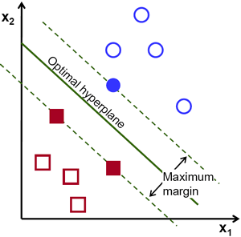
SVM – 3 of 5
Uses nonlinear mapping to transform the original training data into a higher dimension.
Within this new dimension, it searches for the linear optimal separating hyperplane.

Slide 15
Support Vector Machine (SVM) – 4 of 5
The core concept of SVM is the margin, which is the distance between the hyperplane (decision boundary) and the nearest data points from each class. SVM seeks to maximize this margin to improve model accuracy.
These are the data points that lie closest to the decision boundary. They are pivotal in defining the position and orientation of the hyperplane. Their removal would alter the hyperplane's position.
Kernels allow SVM to solve non-linear classification problems. They transform the input space into a higher dimensional space where a linear separator is feasible, without the high computational cost of the transformation.
SVMs are widely used in various fields such as image classification, bioinformatics, handwriting recognition, and more, due to their effectiveness in handling high-dimensional data and their ability to model complex non-linear decision boundaries.

Slide 16
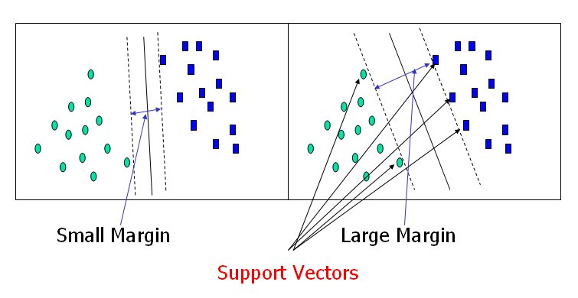
SVM – 5 of 5

Slide 17
Class Activity
Let’s implement the following classification techniques:
Logistic regression (two-class problems)
Softmax regression (multi-class problems)
Naïve Bayes
SVM

